Slide 1


Welcome to the
OGT Prep Session!!!
#1
(science)
Time to pass the OGT!!!

Slide 2
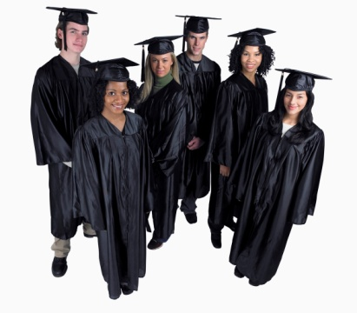
You must pass ALL 5 tests to get
your ‘full’ diploma at graduation. This is the first key to career building.
Every 10th grader in the State of Ohio MUST complete the OGT testing at the Spring Testing.
If you do not pass, you are required to take the OGT until you pass or graduate, with just a ‘certificate’.
Transferees MUST still take the OGT.

Slide 3

What do you have to do to PASS?
Prepare/practice
Testing beings next Monday with the Reading test
You can be successful…. If you prepare

Slide 4

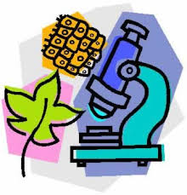
A little about the science OGT….
Includes: Physical science, Earth Science, Biology, Ecology, Chemistry and Physics (these last two are limited to what you learn in physical science).
Your tests are the week of March 10-14th

Slide 5
What does the OGT consist of?
Three types of questions
44 questions
Multiple choice (1 pt) (~#35)
Short answer (2 pts) (~#6)
Extended response (4 pts) (~#3)
Short-answer and extended-response questions require you to write a response and show your work.
If you do not answer Short Answer/Extended Response questions, you will not pass the OGT’s regardless of how many Multiple Choice questions you answer correctly.
There may be 5-10 field testing questions present which will not count on your score.
You will be provided an OGT calculator for your Science test.

Slide 6
What does this test look like??
You will have 2 documents.
1. Answer document, you put ALL your answers in. This is used for all 5 tests. You will ‘set it up’ the on Monday the first day.
2. Testing document, this has all the questions in it. You will receive a new test each session.
ONLY ONE test per day.
Testing times are 9:30am or 6:30pm
Check your Kmails for information about your test.

Slide 7
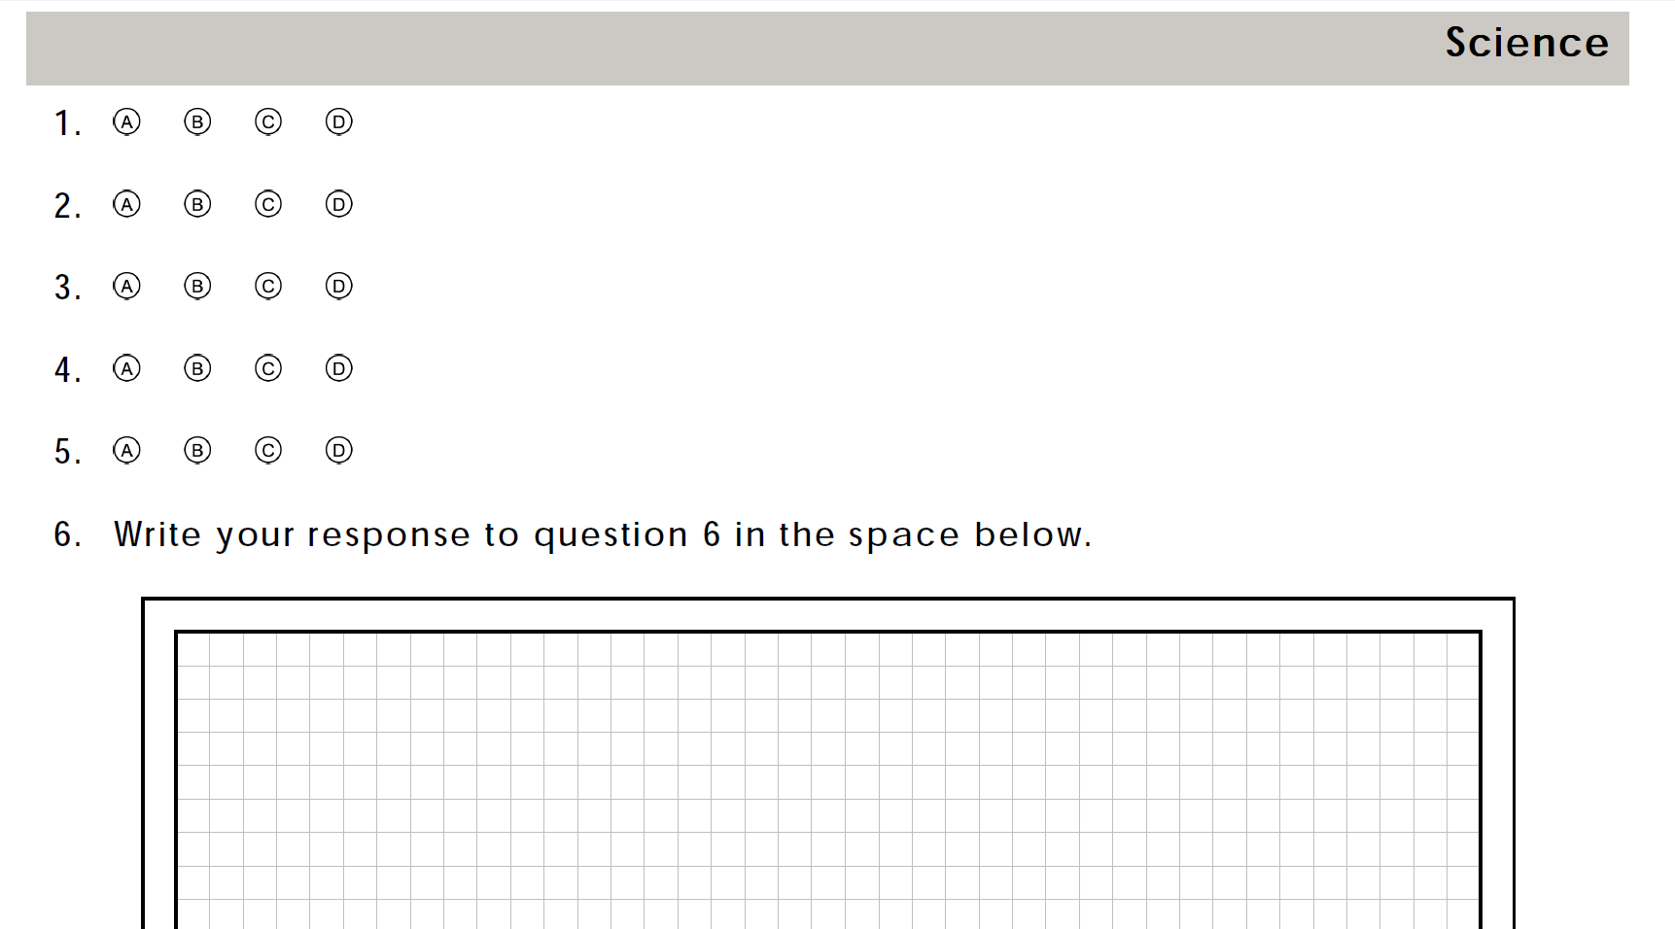
The Answer Document
Fill in bubbles entirely
No stray marks
Write extended response and short answer in grid paper.
There are Roughly:
32 MC
4SA
2ER

Slide 8

Extended Response (4 pts) & Short Answer (2 pts)
If you want to pass the OGT you have to respond to these!!!
Write at least 5 sentences including intro sentence and conclusion
Make sure you answer all parts of the question
Pretend you are writing for an idiot.
The graders know nothing so write, write, write!!!!

Slide 9

Regular Time
You have 2 ½ hours
That breaks down to roughly…
3 minutes per Multiple Choice
8 minutes per Short Answer
11 minutes per Extended Response
**I have never had a student go 2 ½ hours
So time should NOT be an issue.
If your time is up before completing the practice test then mark where you are when time is up..… then complete the test.

Slide 10
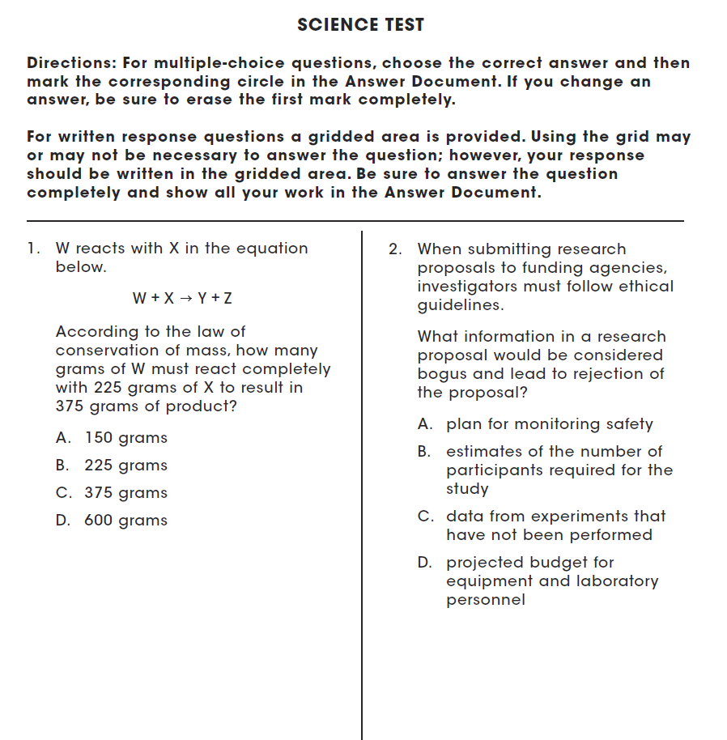
Test Booklet
Write:
Thoughts
Drawings
Cross off answers
Pick apart the question stem
MARK it UP!
You can write on the real test booklet.
On the practice test get in the habit. Mark your difficulties, problem areas and thoughts, as well as time.
I may need to look over your test to help you and this gives me insight…

Slide 11
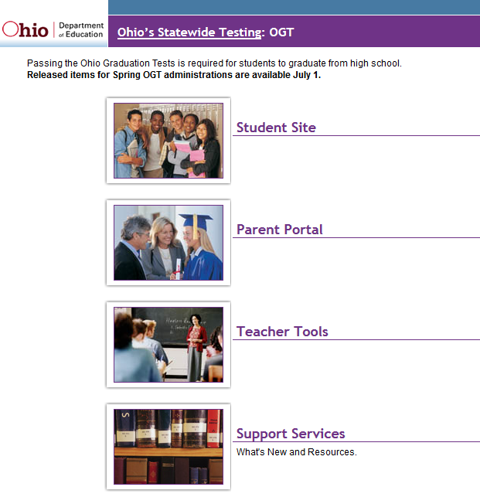
Some other practice helps…
ODE’s Success Website with practice tests….

Slide 12
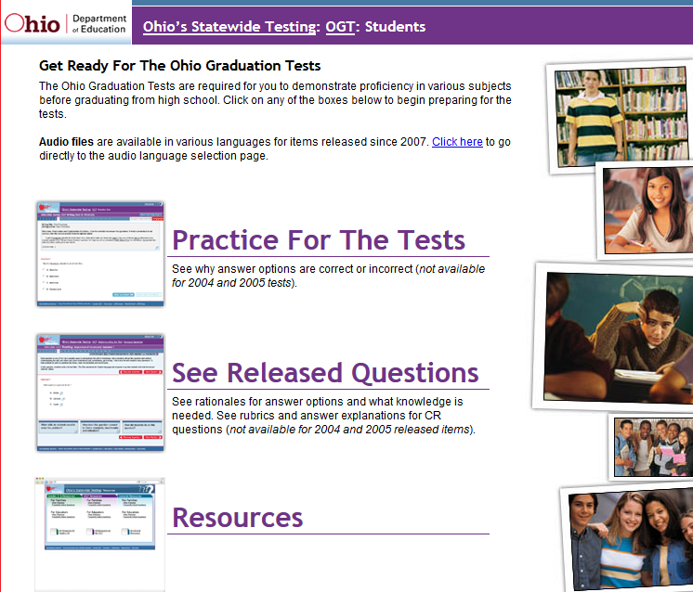

Slide 13
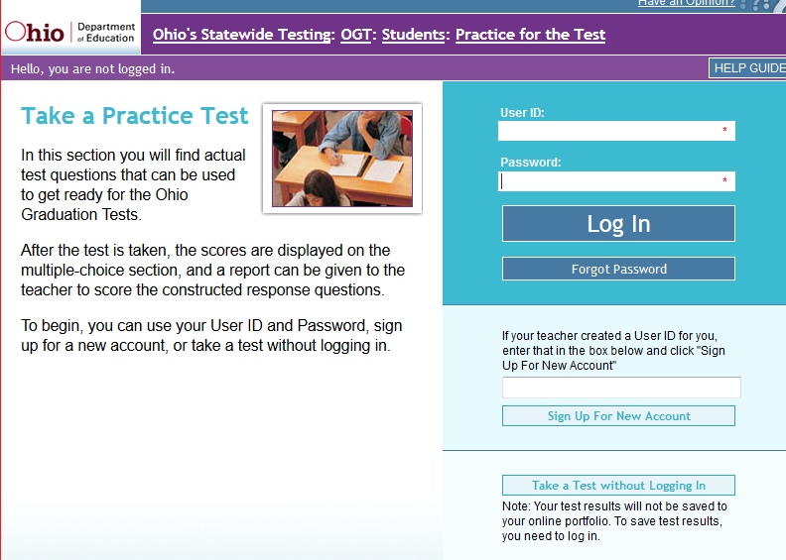

Slide 14
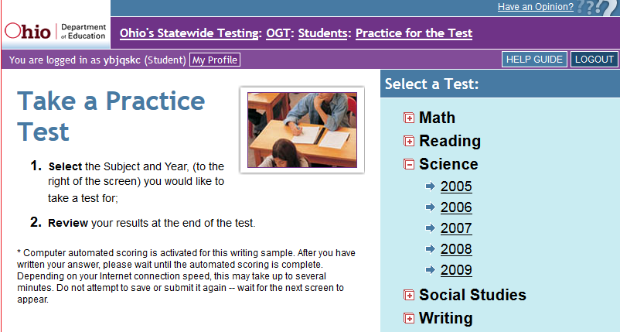

Slide 15
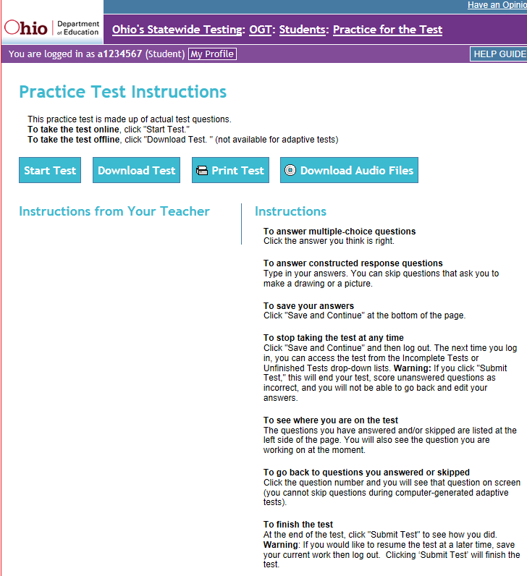

Slide 16
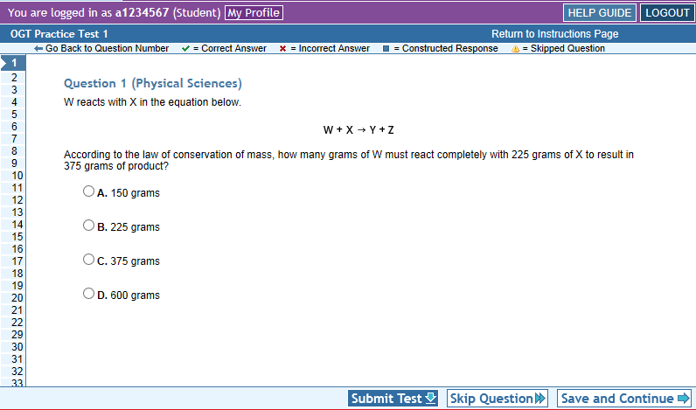

Slide 17
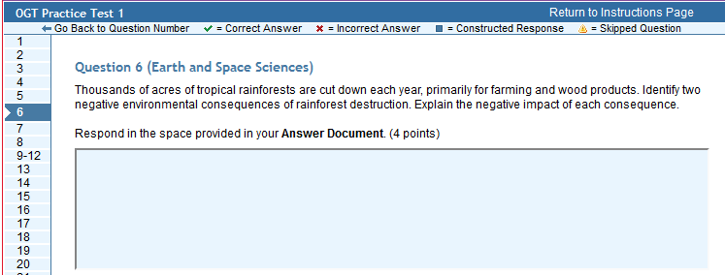

Slide 18
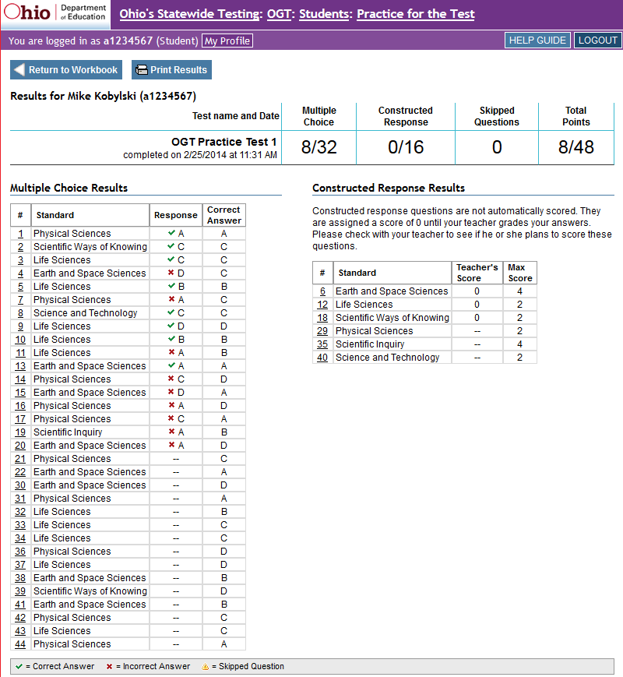
When you complete your test, you will get results.

Slide 19
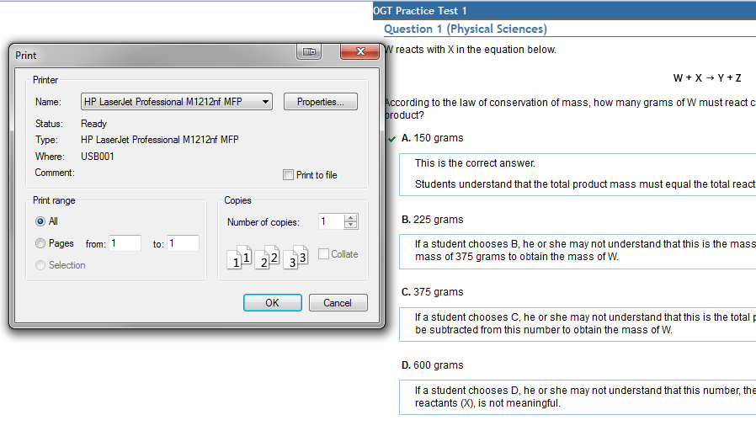
View the comments about the answers
View the comments about the answers

Slide 20
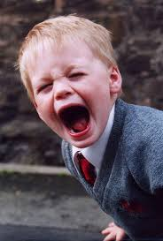
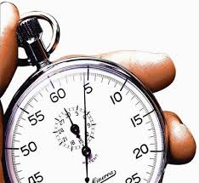
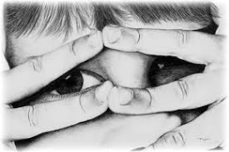
So let’s get started….
Accept the file transfer answer document and test.
You will need to take the practice test in as real-life of a setting as possible:
Quiet
2 ½ hours
No interruptions
Don’t peek at the test!
Print both the test and answer document

Slide 21
Commonly asked questions
What if I don’t pass one or more parts of the OGT?
Students who do not pass one or more tests on their first attempt will retake the tests they need to pass during their junior and senior years. Ohio Graduation Tests are administered each fall and spring, with an optional summer administration available.
What if I am sick that day?
You need to make every attempt to be at the OGT. If you are very ill, contact your site proctor immediately so you can discuss the best plan for the situation.
Am I still going to be responsible for my regular course work the week of OGT?
This will depend on your course and teacher. Most teachers will lighten the course load but you will need to check with each one.

Slide 22
Let’s get started with the
Multiple choice questions.

Slide 23
Physical Science
4. Jackie used a portable electric drill to remove screws from a broken wooden table. He noticed that the screws holding the table together were warm to the touch after being removed from the wood.
What explains this phenomenon?

Slide 24
Important items from question
-used a portable electric drill
-screws
-were warm
-after being removed

Slide 25
4. Jackie used a portable electric drill to remove screws from a broken wooden table. He noticed that the screws holding the table together were warm to the touch after being removed from the wood.
A. Mechanical energy from the drill was converted into thermal energy due to friction.
B. Electrical energy from the drill was converted into chemical energy due to resistance.
C. Thermal energy from the drill was converted into mechanical energy due to inertia.
D. The process of removing the screw concentrated the thermal energy that was already present in the wood.

Slide 26
Physical Science
4. Jackie used a portable electric drill to remove screws from a broken wooden table. He noticed that the screws holding the table together were warm to the touch after being removed from the wood.
What explains this phenomenon?
A. Mechanical energy from the drill was converted into thermal energy due to friction.
B. Electrical energy from the drill was converted into chemical energy due to resistance.
C. Thermal energy from the drill was converted into mechanical energy due to inertia.
D. The process of removing the screw concentrated the thermal energy that was already present in the wood.

Slide 27
Let’s look at terms as found in the answer
Converted, change into another form, substance, state, or product; transform.
Mechanical energy is the energy associated with the motion or position of an object.
Thermal energy is distinct from heat.
Electrical energy is made available by the flow of electric charge through a conductor.
Chemical energy can be released by a chemical reaction
You can’t do this on the test, but we are here to study and practice FOR THE TEST.

Slide 28
Let’s look at terms as found in the answer
Converted, change into another form, substance, state, or product; transform.
Mechanical energy is the energy associated with the motion or position of an object.
Thermal energy is distinct from heat.
Electrical energy is made available by the flow of electric charge through a conductor.
Chemical energy can be released by a chemical reaction

Slide 29
Let’s look at a multiple choice question
Converted, change into another form, substance, state, or product; transform.
Mechanical energy is the energy associated with the motion or position of an object.
Thermal energy is distinct from heat.
Electrical energy is made available by the flow of electric charge through a conductor.
Chemical energy can be released by a chemical reaction

Slide 30
4. Jackie used a portable electric drill to remove screws from a broken wooden table. He noticed that the screws holding the table together were warm to the touch after being removed from the wood.
A. Mechanical energy from the drill was converted into thermal energy due to friction.
B. Electrical energy from the drill was converted into chemical energy due to resistance.
C. Thermal energy from the drill was converted into mechanical energy due to inertia.
D. The process of removing the screw concentrated the thermal energy that was already present in the wood.

Slide 31
One down, 43 more to go……

Slide 32
Life Science
5. What structure is absent in the cells of fungi thereby preventing them from performing photosynthesis?

Slide 33
5. What structure is absent in the cells of fungi thereby preventing them from performing photosynthesis?
What are the important things which you need to understand in this question to answer it correctly?

Slide 34
5. What structure is absent in the cells of fungi thereby preventing them from performing photosynthesis?
In fungi
what is structures (Not process)
are absent or missing
preventing photosynthesis from occurring.

Slide 35
5. What structure is absent in the cells of fungi thereby preventing them from performing photosynthesis?
What do you know about fungi?
Found on trees or forest.
Brown or tan, dark in color.
Does not move.
Ok, now let’s look at possible answers……

Slide 36
5. What structure is absent in the cells of fungi thereby preventing them from performing photosynthesis?
A. cilia
B. nuclei
C. chloroplasts
D. mitochondria
Ok, now let’s look at what the answers mean

Slide 37
5. What structure is absent in the cells of fungi thereby preventing them from performing photosynthesis?
A. cilia
B. nuclei
C. chloroplasts
D. mitochondria
-movement
-genetic center
-Hold chlorophyll
-conversion of food to usable
energy

Slide 38
5. What structure is absent in the cells of fungi thereby preventing them from performing photosynthesis?
A. cilia
B. nuclei
C. chloroplasts
D. mitochondria

Slide 39
5. What structure is absent in the cells of fungi thereby preventing them from performing photosynthesis?
A. cilia
B. nuclei
C. chloroplasts
D. mitochondria
-Hold chlorophyll which allows plants to undergo photosynthesis.

Slide 40
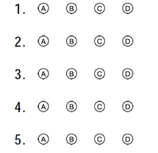
Let’s get continue with another multiple choice questions.

Slide 41
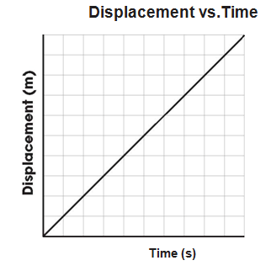
Physical Science
14. A student records the position of a car every second for a period of time and plots the following displacement and time graph.

Slide 42
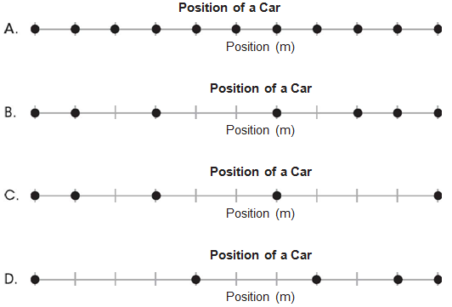
14. A student records the position of a car every second for a period of time and plots the following displacement and time graph.
Illustrated below is the change in position of a car every second. Which observation of an object moving from left to right did the student record?

Slide 43
Illustrated below is the change in position of a car every second. Which observation of an object moving from left to right did the student record?

Slide 44
Illustrated below is the change in position of a car every second. Which observation of an object moving from left to right did the student record?
Up one over one

Slide 45
Illustrated below is the change in position of a car every second. Which observation of an object moving from left to right did the student record?
Up one over one

Slide 46
Illustrated below is the change in position of a car every second. Which observation of an object moving from left to right did the student record?
What all the lines might look like.

Slide 47
Test Taking Tips for Short Answer and Extended Response Questions
Read the directions carefully.
If the question is asking for facts, do not give your personal opinion on the topic.
Make an outline before writing. This way your response will be more organized and fluid. (FWM)
Address all parts of the question,
i.e. List and explain…..
Proofread your work and correct any errors. DID you answer the question?

Slide 48
Short Answer Questions
29. Most bacteria reproduce asexually. Mammals reproduce sexually. Describe how these two methods of reproduction differ with respect to the genetic makeup of the offspring produced.
(2 points)

Slide 49
Short Answer Questions
29. Most bacteria reproduce asexually. Mammals reproduce sexually. Describe how these two methods of reproduction differ with respect to the genetic makeup of the offspring produced. (2 points)
asexually vs sexually
how do both methods of reproduction differ
relating to genetic makeup of the offspring
(2 points)

Slide 50
2 point question: describe difference
asexual & sexual reproduction differ genetically
asexually
sexually
Because
Because

Slide 51
2 point question: describe difference
asexual & sexual reproduction differ genetically
asexually
sexually
Because inherited traits come from a single parent, offspring are genetically identical to the parent.
Because inherited traits come from 2 different parents, the offspring have new combinations of traits, which increases genetic diversity.

Slide 52
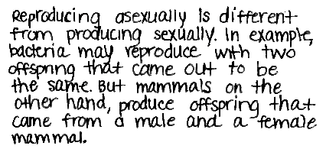
0 pts
1 pt
2 pts
Describe how these two methods of reproduction differ with respect to the genetic makeup of the offspring produced.

Slide 53
FACT:
— Students have to answer correctly 18-21 questions out of 44 to score 400 or higher

Slide 54
FACT:
— Students have to answer correctly 18-21 questions out of 44 to score 400 or higher
YES you need about 50% to PASS
Do you think you can do that????
—Remember…5-6 questions on every OGT are pilot questions that are not scored….
— OGT does not discriminate on the degree of difficulty per question.

Slide 55
0 pts
1 pt
2 pts
Describe how these two methods of reproduction differ with respect to the genetic makeup of the offspring produced.

Slide 56
0 pts
1 pt
2 pts
Describe how these two methods of reproduction differ with respect to the genetic makeup of the offspring produced.

Slide 57
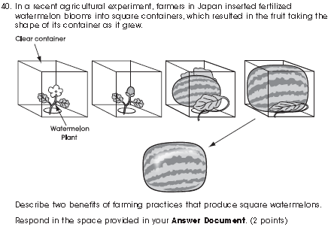
Short Answer
Read the question
Evaluate the pictures
Identify what you are being asked to do

Slide 58
Short Answer
Read the question
Evaluate the pictures
Identify what you are being asked to do
The container
the shape of the
melon to be
square
2 Benefits: 2 ways
that this is helpful

Slide 59
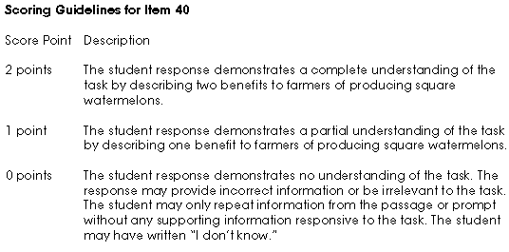
Sample Answers:

Slide 60
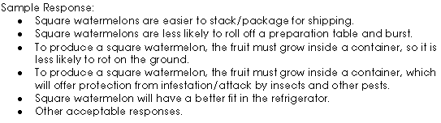
Sample Responses: you need 2
Be sure that you don’t repeat yourself…bigger/larger, easier to handle/easier to cut
Be specific in what that benefit is…”better” could mean anything, describe how it is better to be square rather than anything else

Slide 61
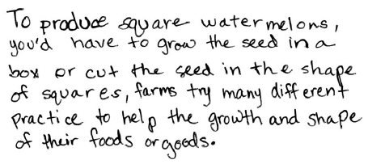
Student response #1
What would you rate this answer? Why?
  2
  1
  0

Slide 62
Student response #1
What would you rate this answer? Why?
  2
  1
  0
  It describes the process, but …
  does NOT describe benefits.

Slide 63
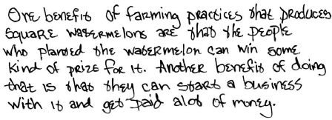
Student response #2
What would you rate this answer? Why?
  2
  1
  0

Slide 64
Student response #2
What would you rate this answer? Why?
  2
  1
  0
  The benefit is not related to the square shape of the watermelon.

Slide 65
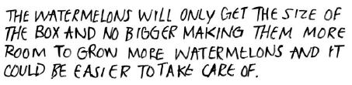
Student response #3
What would you rate this answer? Why?
  2
  1
  0

Slide 66
Student Response #3
Student response #3
What would you rate this answer? Why?
  2
  1
  0
  Only 1 benefit is listed: Watermelons will only get the size of the box making more room to grow more

Slide 67

Student response #4
What would you rate this answer? Why?
  2
  1
  0

Slide 68
Student Response #4
Student response #4
What would you rate this answer? Why?
  2
  1
  0
  Both benefits are clearly stated:
  Decrease in maximum space needed to store
  Easy transport because they fit into boxes

Slide 69
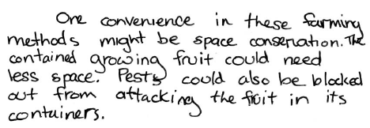
Student response #5
What would you rate this answer? Why?
  2
  1
  0

Slide 70
Student response #5
What would you rate this answer? Why?
  2
  1
  0
  Benefits are clearly stated:
  Space conservation/needs less space
  Pests could be blocked out from attacking the fruit

Slide 71
How to write short answer…..
Topic Sentence (restates question, previews answer)
Supporting details
  Detail 1
  Detail 2
  Detail 3
Conclusion (summarizes answer)
Minimum 5 Total Sentences
Check for grammar and sentence structure
Make sure detail support answer

Slide 72
Scoring 0-5
0-Insufficient-didn’t answer the question
1-One sentence. Didn’t fully answer the questions with supporting details or include intro or closing sentence.
2-May have included intro sentence and 1 detail
3-Sufficient. Missing a detail and/or intro closing sentence.
4- Answered question, but missing intro or closing sentence
5- Exemplary! Answered question fully and included intro and closing sentence.

Slide 73
Sample Responses: you need ‘4’
During the 1900s, many chemical companies invented a variety of plastics. Plastics are used in a wide array of technologies, including food packaging. Describe the positive and negative effects of the widespread use of plastic for food packing?
What score would you give and why?

Slide 74
Sample Responses: you need ‘4’
During the 1900s, many chemical companies invented a variety of plastics. Plastics are used in a wide array of technologies, including food packaging. Describe the positive and negative effects of the widespread use of plastic for food packing?

Slide 75
Response #1: What score would you give?
Describe the positive and negative
Plastic food packing has had both positive and negative effects. One positive effect is that is makes life a little easier for humans and keeps food fresher by keeping out more air than other materials. One Negative effect is that plastic does not biodegrade quickly, therefore it is polluting the earth.
What would you rate this answer? Why?
  4
  3
  2
  1
  0
Notes:
4.0

Slide 76
Response #1: What score would you give?
Describe the positive and negative
Plastic food packing has had both positive and negative effects. One positive effect is that is makes life a little easier for humans and keeps food fresher by keeping out more air than other materials. One Negative effect is that plastic does not biodegrade quickly, therefore it is polluting the earth.
1
2
3
What would you rate this answer? Why?
  4
  3
  2
  1
  0
Notes:
4.0

Slide 77
Response #2: What score would you give?
Describe the positive and negative
Plastic food packaging is cheap and keeps food safe, but it can put harmful chemicals on the food it comes in contact with.
What would you rate this answer? Why?
  4
  3
  2
  1
  0
Notes:
1.5

Slide 78
Response #2: What score would you give?
Offers no information as to why that is true?
Describe the positive and negative
1
Plastic food packaging is cheap and keeps food safe, but it can put harmful chemicals on the food it comes in contact with.
2
What would you rate this answer? Why?
  4
  3
  2
  1
  0
Notes:
1.5

Slide 79
Response #3: What score would you give?
Describe the positive and negative
Product life increased, but prices increased as well.
What would you rate this answer? Why?
  4
  3
  2
  1
  0
Notes:
1.0

Slide 80
Response #3: What score would you give?
Describe the positive and negative
1
2
Product life increased, but prices increased as well.
What would you rate this answer? Why?
  4
  3
  2
  1
  0
Notes:
1.0

Slide 81
Response #4: What score would you give?
Describe the positive and negative
The positives of using plastics are that they make it easier to store foods and the foods will stay fresh longer. The negatives are that plastics are hard to get rid of and decompose so they cause harm to the environment animals/animals habitats.
What would you rate this answer? Why?
  4
  3
  2
  1
  0
Notes:
3.0

Slide 82
Response #4: What score would you give?
Describe the positive and negative
The positives of using plastics are that they make it easier to store foods and the foods will stay fresh longer. The negatives are that plastics are hard to get rid of and decompose so they cause harm to the environment animals/animals habitats and they cost money to make.
1
2
3
4
What would you rate this answer? Why?
  4
  3
  2
  1
  0
This is part of a result of ‘hard to get rid of’ NOT another item
Notes:
3.0

Slide 83
Response #5: What score would you give?
Describe the positive and negative
I really do not know.
What would you rate this answer? Why?
  4
  3
  2
  1
  0

