Slide 1
Formula Writing by Jan Cosner
These lessons will give you a formula to follow when answering test questions. It makes essay questions easier!

Slide 2
Follow the steps for Formula Writing
Figure out the topic or answer. Underline it in the question.
Draw a wheel with the number of spokes asked for in the question (two or four). Write the topic or answer in the middle of the wheel.
Fill the spokes with examples, facts, or reasons.
Snap it! Extend your answer with and or because.
Write a topic sentence starting with the words in the middle of the wheel.
Next, turn each spoke into a complete sentence including the snap words.

Slide 3
1. Figure out the topic or answer. Underline it in the question.
Predict what a teardrop shape will do when it falls through a liquid. (2 pts)

Slide 4
2. Draw a wheel with the number of spokes asked for in the question (two or four). Write the topic or answer in the middle of the wheel.
Predict what a teardrop shape will do when it falls through a liquid.
teardrop shape falls through a liquid

Slide 5
3. Fill the spokes with examples, facts, or reasons.
Predict what a teardrop shape will do when it falls through a liquid.
Falls straight w/o wobbling
teardrop shape falls through a liquid
Falls quickly

Slide 6
4. Snap it! Extend your answer with and or because.
Falls straight w/o wobbling
teardrop shape falls through a liquid
Falls quickly
Because it’s heavier
on the bottom
Because of its aerodynamic
shape
I am writing about….
Write a topic sentence starting with the words in the middle of the wheel.
Next, turn each spoke into a complete sentence including the snap words.

Slide 7
OGT
Formula Writing Model
Short Answer (2 points)
TS – 2EX
Topic
or
Answer
Example 1
Example 2
and or because
Detail
and or because
Detail
Notes:
And – What will happen? Because – Why?
What else do you know?

Slide 8

Putting it All Together
Punch out the center of your wheel.
Hit the line!
Turn each spoke into complete sentences using snap words (and/because).
Organize your short answer using First, Next, Then, Last.
It’s that easy!!!

Slide 9
Give it a Try!
Agriculture provides food, clothing, and other products through a process that has 4 main parts. Explain at least 2 parts of the agricultural process.
Snap it all
together!
2 parts of the agricultural process
Production
Processing
(What do you know?)
Detail
When crops, meat, dairy & other items are processed into products that can be sold.
(What do you know?)
Detail
When crops or livestock are raised.
Notes:
Other processes you could possibly include: delivery, marketing

Slide 10
Write Your Answer
Remember to HIT THE LINE!
Two parts of the agricultural process are
production when crops or livestock are
raised. Next is processing when crops,
meat, dairy, and other items are processed
into products that can be sold.

Slide 11
Formula Writing Model
A strategy to help you respond to OGT /ACT – type discussion/short answer questions.

Slide 12
How much should I write?
OGT
2 points
  Write 3 sentences
4 points:
  Write 5 sentences

Slide 13
Putting it all together…
PUNCH: out the center of your wheel with a good topic sentence
HIT: the line with your supporting information
SNAP: each spoke into complete sentences using your snap words (and/because)
WRAP: it up by organizing your ideas using words such as First, Next, Then, Last

Slide 14
Let’s Try One…
. (2 pts)

Slide 15
PUNCH!
. (2 pts)
PUNCH: out the center of your wheel with your answer/topic

Slide 16
HIT!
. (2 pts)
…
HIT: the line with your supporting information

Slide 17
SNAP!
. (2 pts)
…
SNAP: each spoke into complete sentences using your snap words (and/because)

Slide 18
WRAP!
Are similar because
Sexual and Asexual Reproduction
Are different because
SAME
DIFFERENT
Methods of producing a new organism
Pass on genetic information from one generation to the next
Asexual – no fusion of gametes; offspring are identical to parent; several different methods: budding, regeneration, binary fission, runners; common in simpler organisms
Sexual – fusion of gametes; offspring are combination of parental genetic info; common in more complex organisms
WRAP: it up by organizing your ideas using words such as First, Next, Then, Last, or other appropriate words.

Slide 19
2010-11 Schedule of Topics
Week of:
November 1 Explain
November 8 Predict
November 15 Compare (same and different)
November 29 Answering Two Questions
December 5 Cause and Effect
December 12 Reading Graphs and Charts

Slide 20

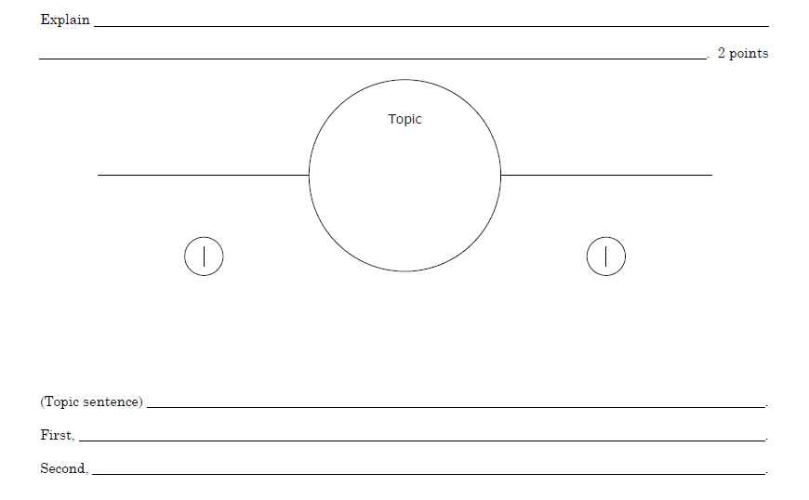

Slide 21
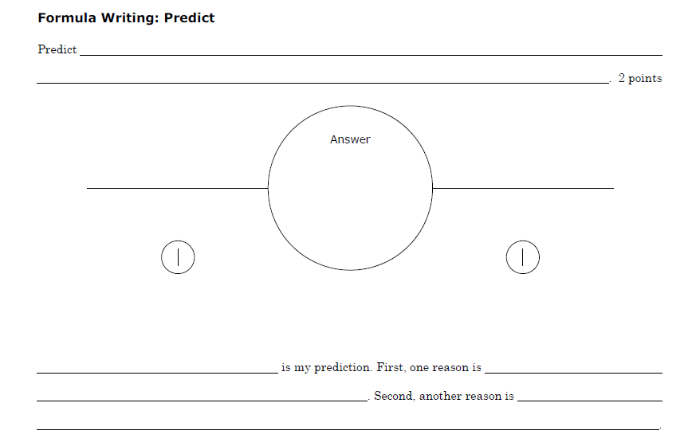

Slide 22
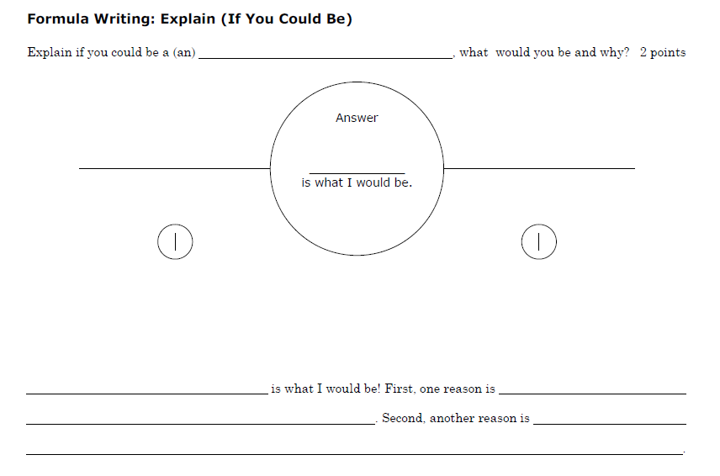

Slide 23
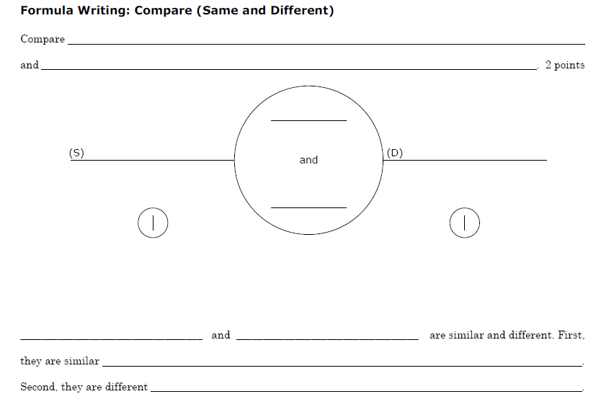

Slide 24
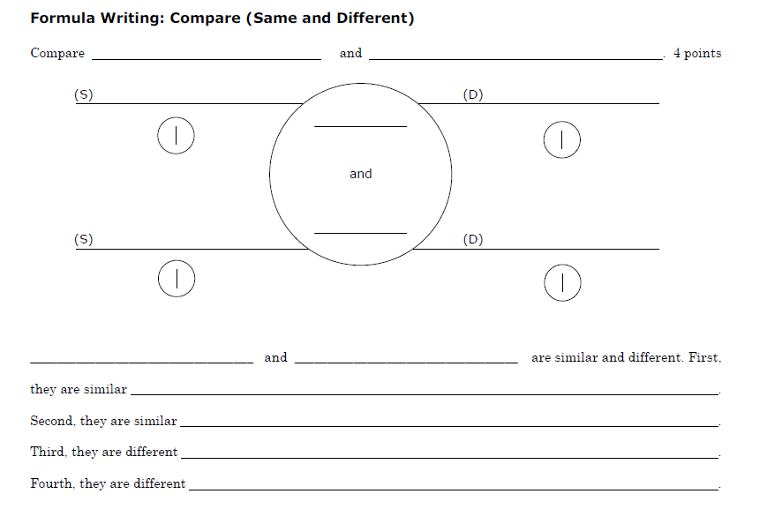

Slide 25
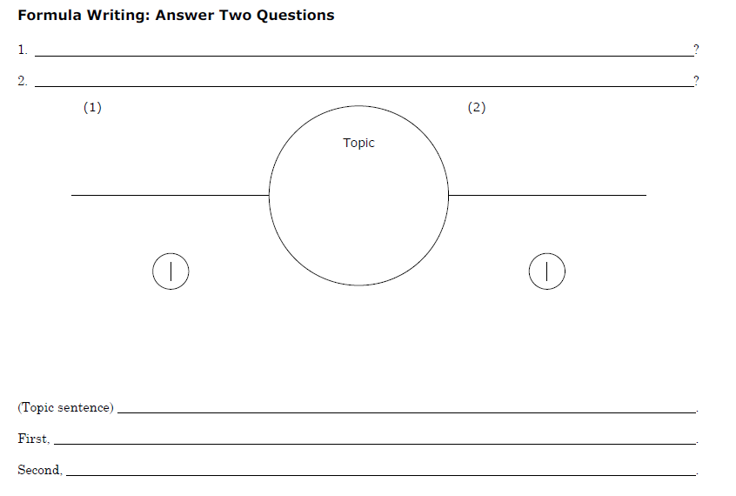

Slide 26
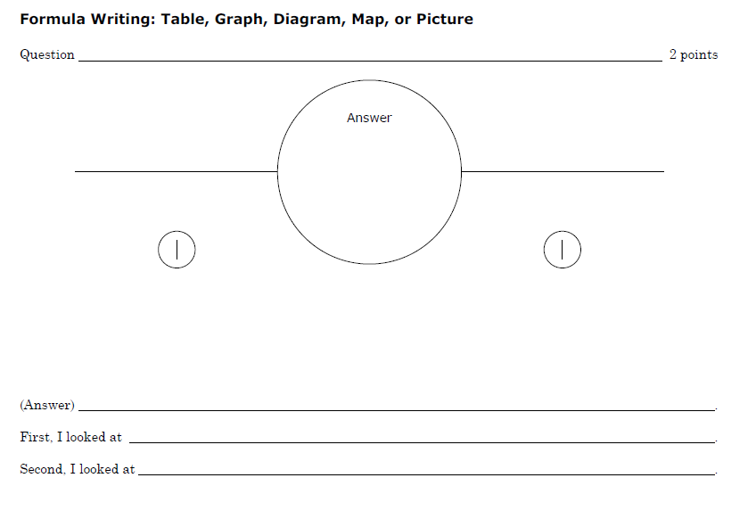

Slide 27
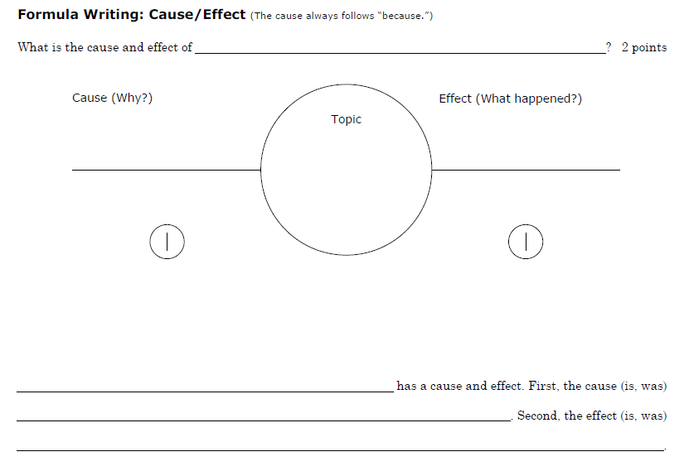

Slide 28
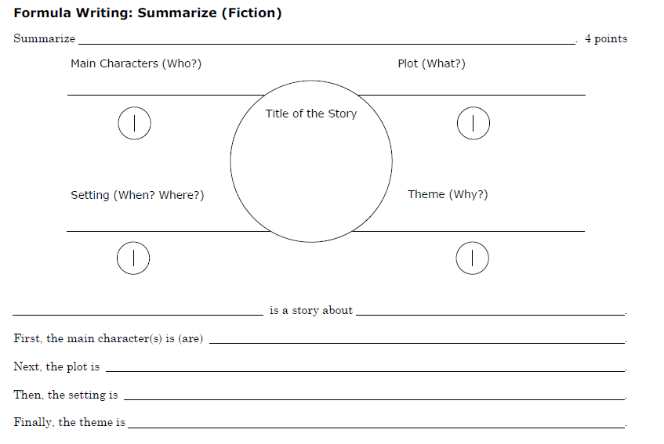

Slide 29
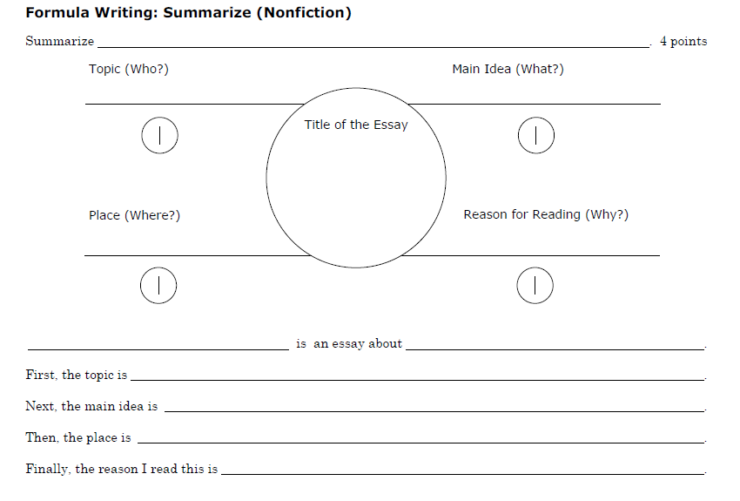

Slide 30
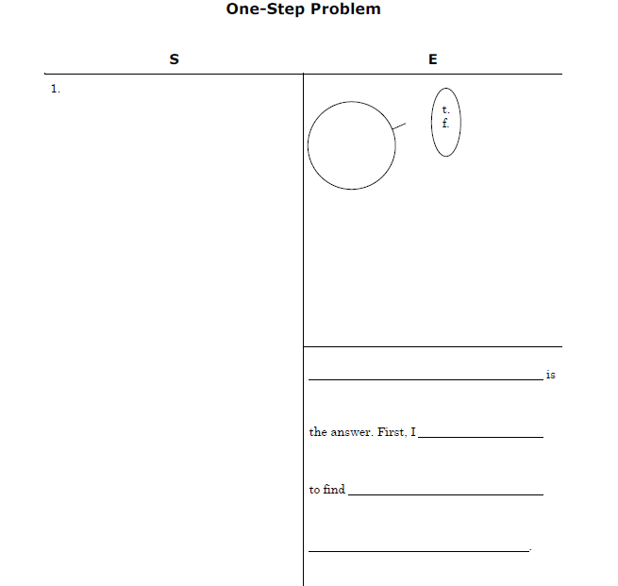

Slide 31

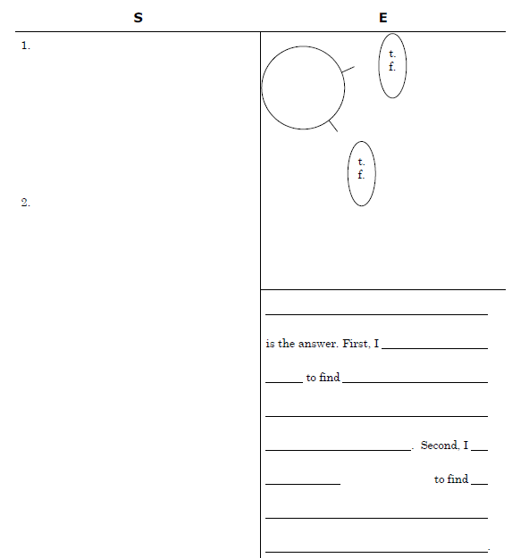

Slide 32

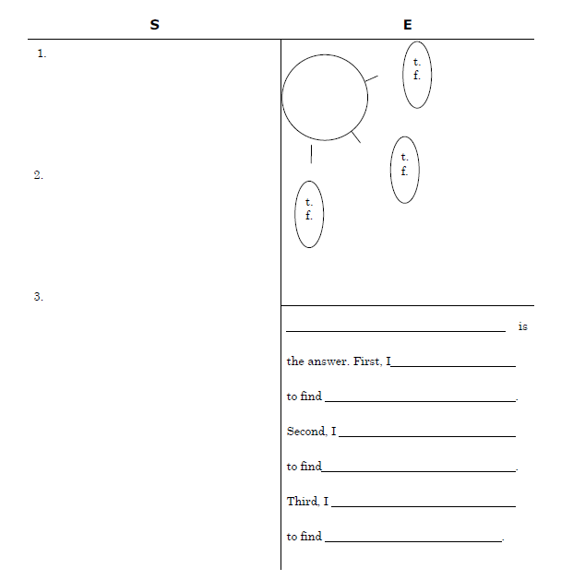

Slide 33
Formula Writing
Physical Science

Slide 34

Basic Kinds of Formulas
Explain/describe
Predict
Compare
Answer Two Questions
Table, Graph, Map, Diagram or Picture
Cause and Effect
And others!

Slide 35
Why learn these formulas?
They will help you pass the OGTs!
They will help you get a good grade on tests.
You don’t have to think about how to write your answer, just think about what is the answer.
You will know you are giving a complete answer.

Slide 36
This is a good idea to use for the Doppler Lab Discussion!
Use it to help you give a thorough answer.

Slide 37
Compare longitudinal and transverse waves.
Notes:
And/because

Slide 38
Longitudinal Waves
Transverse waves
Write your answer in the chat box. Remember to include all parts of the answer!
Notes:
I will give tools to a couple of the best ones and have them write it here.

Slide 39
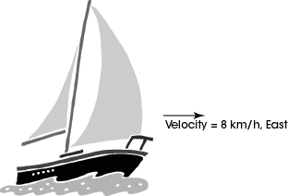
A sailboat is moving at a constant velocity of 8 km/h eastward as shown in the picture below.
Describe two opposing forces acting on the boat and explain how each force affects the boat.

Slide 40
Describe two opposing forces acting on the boat and explain how each
force affects the boat.

Slide 41
Slow down!
Take 10 minutes for each question. Read it carefully and think about it.
Make notes in the test booklet, underline, circle important information.
Brainstorm! Think of as many answers as possible.
Spelling doesn’t count in science.

Slide 42
Compare physical and chemical change.
Notes:
And/because

Slide 43
Physical change
chemical change
Write your answer on a piece of paper. Turn on some music to help you write. Remember to include all parts of the answer!
Notes:
I will give tools to a couple of the best ones and have them write it here.

Slide 44
Proofread!
You need to go back and read out loud what you’ve actually written.
Make any necessary corrections.
Did you capitalize, use punctuation, best handwriting? (for the OGT test spelling and punctuation don’t count)

Slide 45
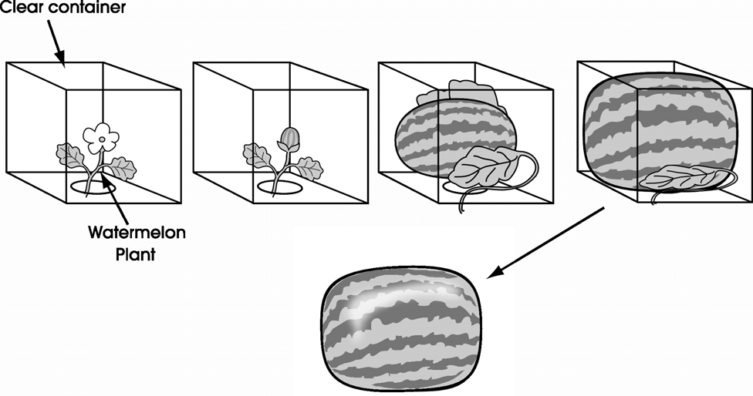
In a recent agricultural experiment, farmers in Japan inserted fertilized watermelon blooms into square containers, which resulted in the fruit taking the shape of its container as it grew.
Describe two benefits of farming practices that produce square watermelons.
Respond in the space provided in your Answer Document. (2 points)

Slide 46
In a recent agricultural experiment, farmers in Japan inserted fertilized watermelon blooms into square containers, which resulted in the fruit taking the shape of its container as it grew.
Describe two benefits of farming practices that produce square watermelons.

Slide 47
Formula Writing
Same and Different
Let’s go for a hard one today!
4 points!!!

Slide 48
reflection
refraction
Reflection
refraction

Slide 49
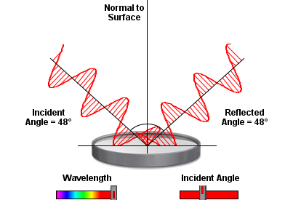
reflection

Slide 50
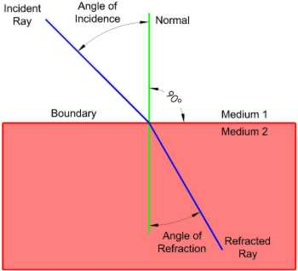
refraction

Slide 51
reflection
refraction
reflection
refraction
Reflection
refraction

